Slide 1
Cloud security challenge
VPBank Hackathon
Lê Quang Anh – nhóm 132
lequanganh97@gmail.com

Slide 2
Cloud security challenge
Requirements
  Web application with insecure design (AWS misconfiguration(s), OWASP top 10)
  IaC solutions
  Solutions to vulnerability in the web application
  Security solutions to defend web application with a reasonable cost

Slide 3
Web application with vulnerabilities (AWS misconfiguration(s), OWASP top 10)
Application: Public information board web application
Functions:
  Create post public message for other user to read.
  Create private message for note.
IaC:
  Application deploy using Ansible
Vulnerability:
  SQL injection (Owasp top 10 2021 – A03:2021)
  Cryptography Failures (Owasp top 10 2021 – A02:2021)
  Software and data integrity failures (Owasp top 10 2021 – A08:2021)
  IDOR (Owasp top 10 2021 – A01:2021)
  Security misconfiguration (Owasp top 10 2021 – A05:2021)

Slide 4
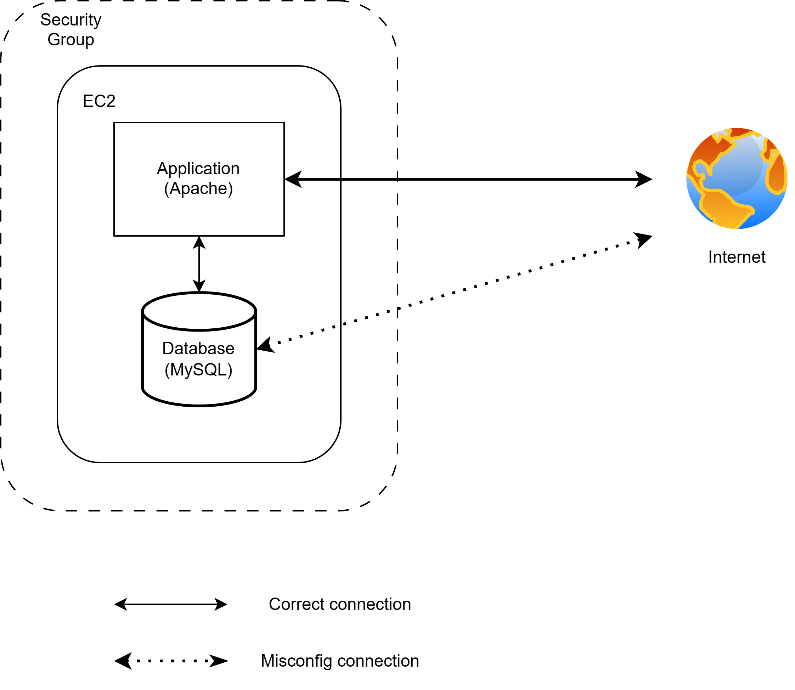
Propose web application
Purpose
  Public information board web application
Architecture
  Application build with PHP running on Apache server
  Application using a SQL database to store user(s) login data, and user(s) post
Deployment
  Web application deployed on a single EC2 machine on AWS with Security group set for Default configuration

Slide 5
Vulnerability
Security misconfiguration: When deploy to AWS, the VM running the application using default security group which allow all traffic to all port with can expose the database port.
SQL injection: Application query on the database without validate the user untrusted inputs which cause SQL injection.
Cryptography Failures: Application encrypt user password and store its inside database but using a weak algorithm like md4, md5 which is easy to crack.
Software and data integrity failures : Application failure to validate the source of interaction to the app, making its possible for user to create data on different user account.
IDOR: When handle information request, application failed to validate whether the request is from correct user which lead to user can read data of other user

Slide 6
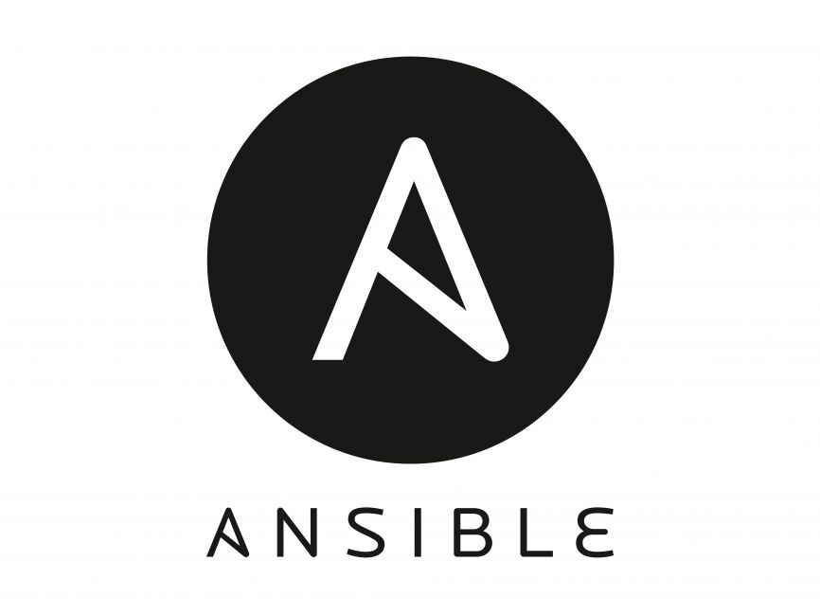
IaC
Application deploy using Ansible which streamline the deployment process and increase the consistency when a application is deploy on various system.

Slide 7
Solutions to vulnerability in the web application
Security misconfiguration
  There is no automated solutions to mitigate or prevent security misconfiguration. There can only code review and rigid checking procedure of code can mitigate this vulnerable.
SQL injection
  Validate user input and escape, filter out dangerous input
Cryptography Failures
  Use new and robust cryptographic algorithm
Software and data integrity failures
  Validate the source of the data before accept it into the system
IDOR
  Validating request that access user data to make sure user can only read what it available to them.

Slide 8
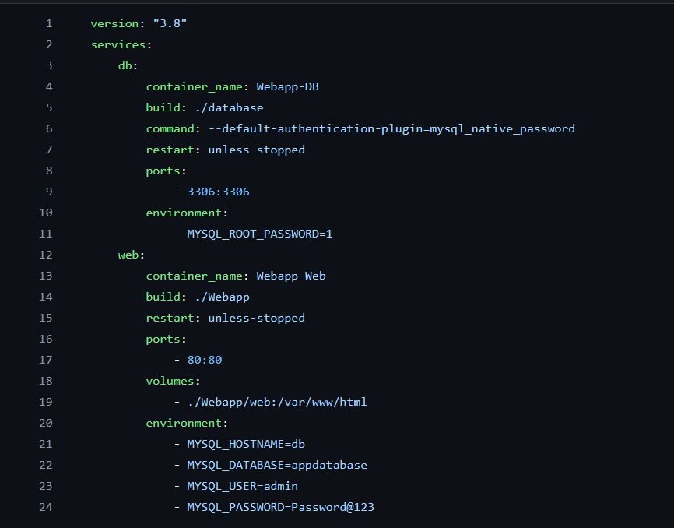
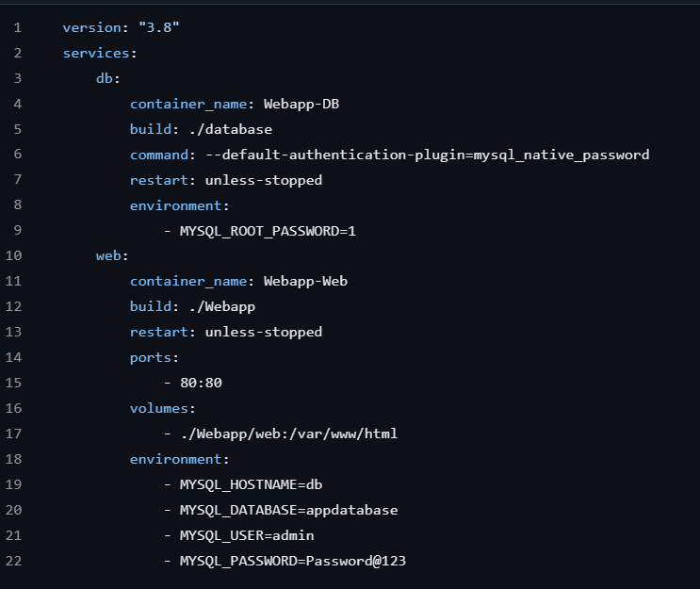
Security solutions to defend web application
Security misconfiguration
Before: Unnecessary port of database was exposed. This port can be detect give NMAP giving threat actor insight to the system
After: Remove unnecessary port

Slide 9
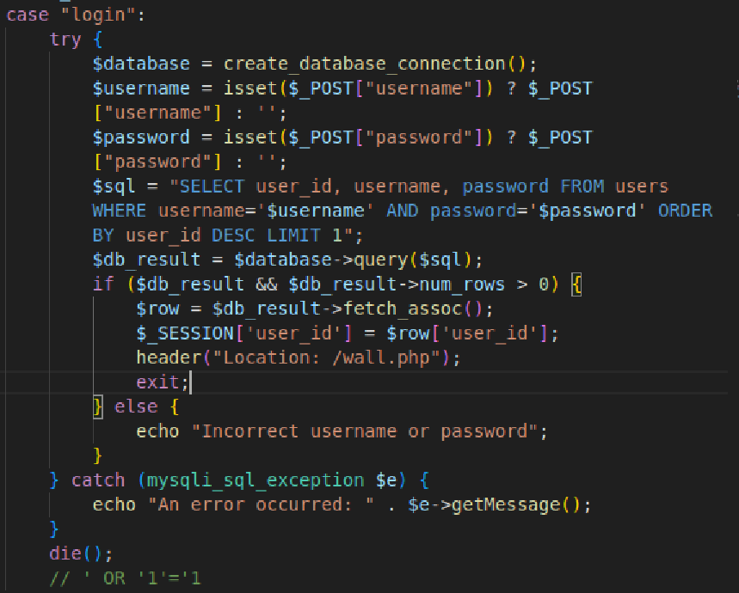
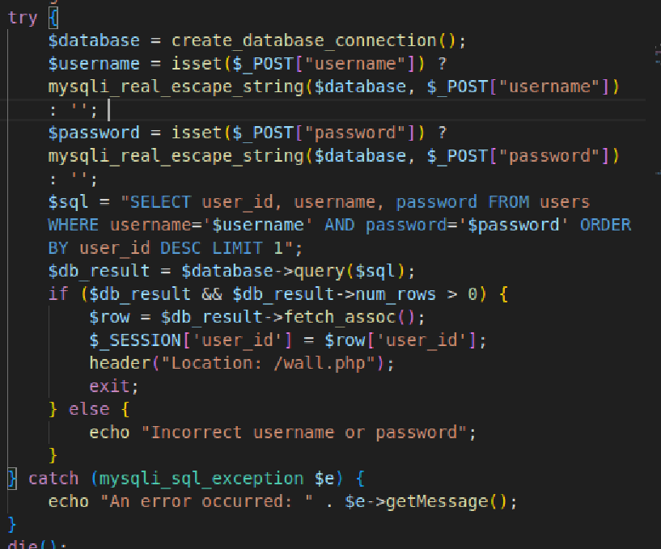
Security solutions to defend web application
SQL injection
Before: No user input validation
After: Using mysql_real_escape_string to filter out all special character from the input to block SQL injection attack

Slide 10
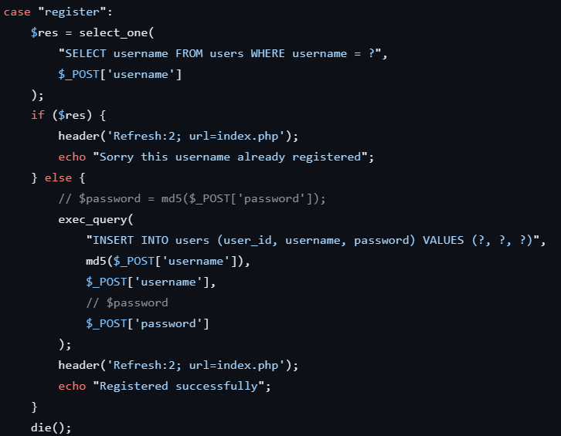
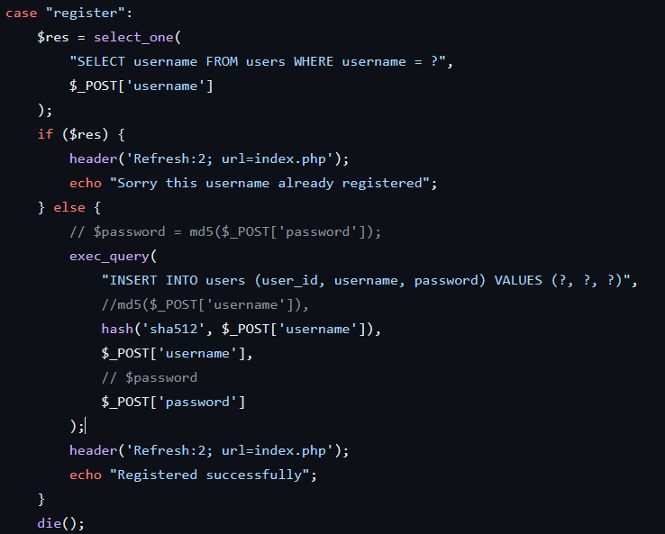
Security solutions to defend web application
Cryptography Failures
Before: User ID created by hashing username with md5 (weak crypto algorithm)
After: Hashing using SHA512 algorithm

Slide 11
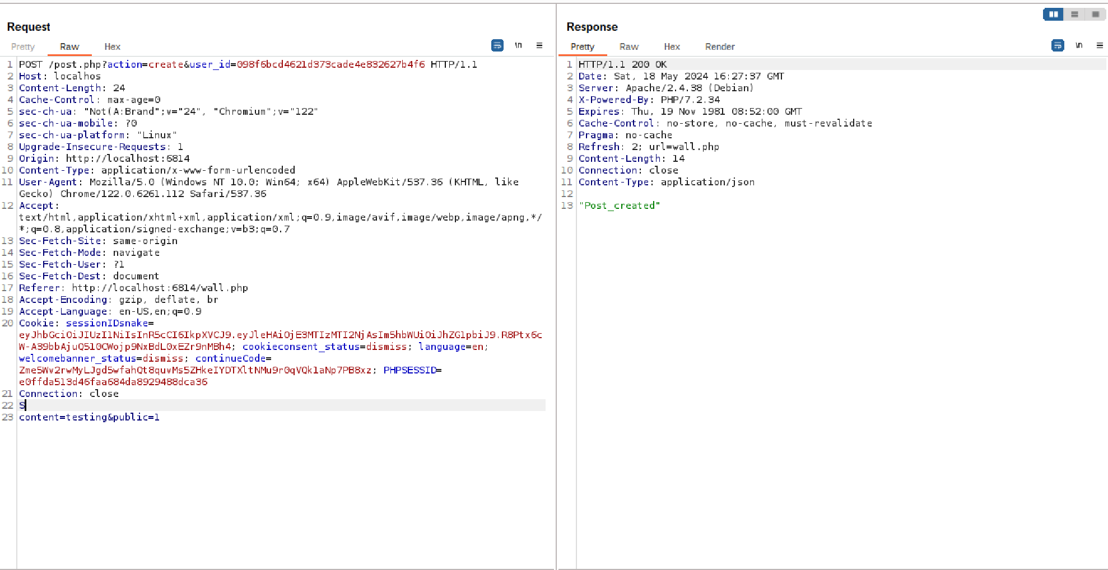
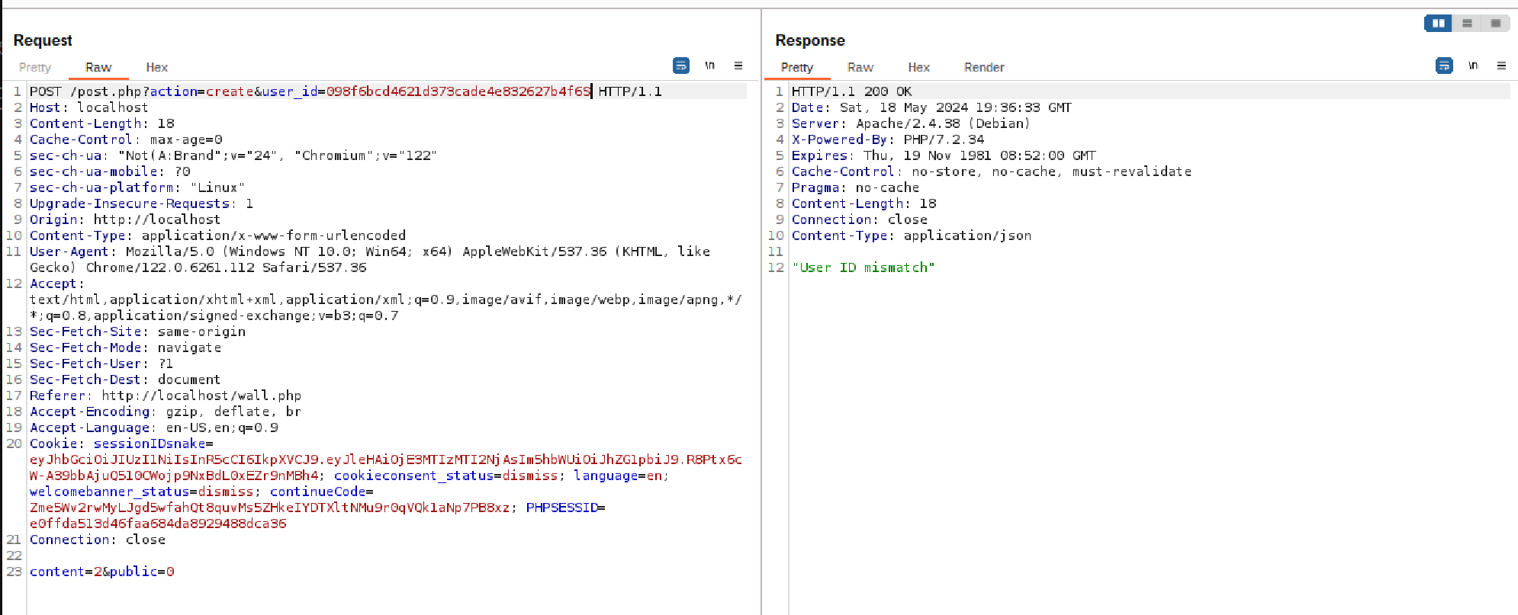
Security solutions to defend web application
Software and data integrity failures
Before: By adding other user_id in the request, its possible to create post credited to other user
After: Checking session ID along side with user_id in the request to make sure request created by the correct user

Slide 12
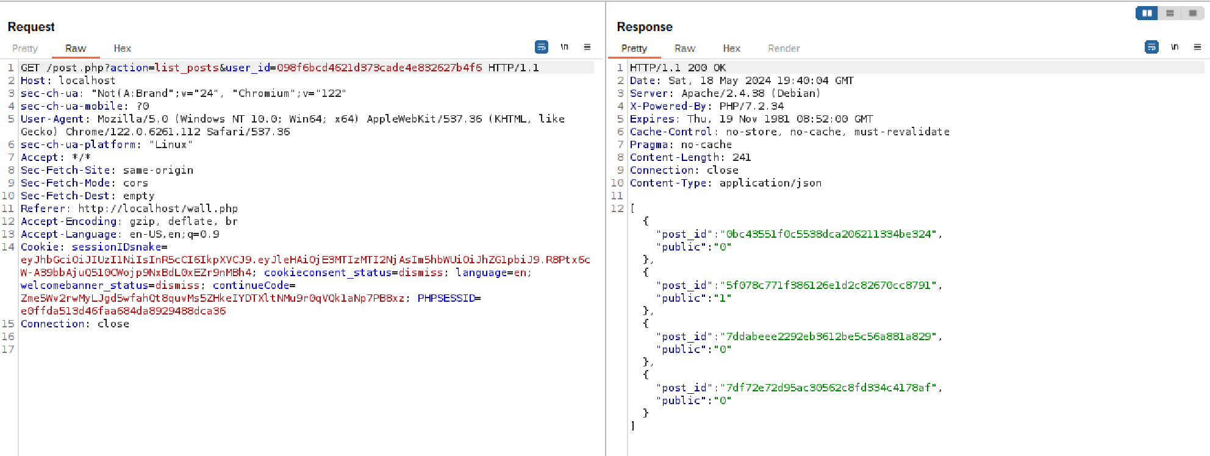
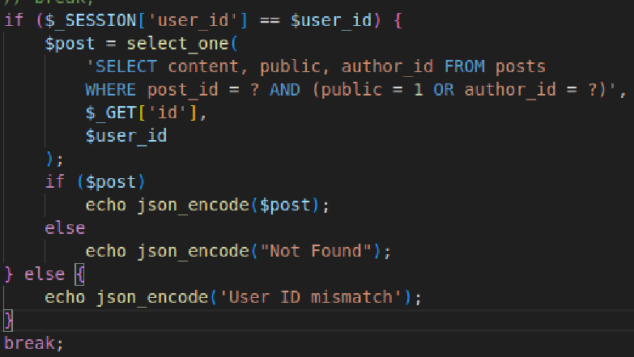
Security solutions to defend web application
IDOR
Before: By adding other user_id in the request, its possible to view id of all post created by other user
After: Checking session ID along side with user_id in the request to make sure user can only view their own post or other people public post.

Slide 13
Security solutions to defend web application with a reasonable cost
Create procedure(s) and a strong culture of testing and reviewing code before deployment. Regularly review and update software, library, ruleset to prevent vulnerability of outdate components.
The first layer of web application security is within the code Itself. It’s the cheapest options but require code reviewer to knowledable about the potential vulnerability within the code in order to patch it.
To further protect the web application, developer can using harden the system to reduce potential attacks surface.
Next, WAF and FW can be deploy to monitor and control the the traffic in/out of the web applications protect the against malicious traffic of bad actor.
Addition to WAF and FW, using SIEM and EDR to have total visibility of any event that happened whether its on endpoint or on network.
Finally, with critical application, a Security Operation System (SOC) is the solution to monitor, protect and react swiftly to cyberthreat 24/7.

Slide 14
Security solutions to defend web application with a reasonable cost
There is no absolute security solution to protect against all the cybersecurity threats. There will always be vulnerabilities in any system so people is moving from vulnerabilities prevention to vulnerabilities resistance. So instead of trying to find and patch ALL the vulnerabilities, now its it about quickly patched up any newly discorvered vulnerabilities and finding way to reduce and mitigate risk to the system.
Further more, security is also heavily dependant on criticality and budget to the application so there is no one size fit all security solution. Each application, company with there own characters require different thing in security.

Slide 15
Appendix: Example of Paid/Opensource solutions
Solutions | Paid | Opensource
SIEM + EDR | AWS Control Tower Splunk IBM Qradar | Wazuh Security Onion Utmstack
WAF | AWS WAF Cloudflare WAF Imperva cloud WAF | Mod Security Open-appsec
FW | AWS Network Firewall Palo Alto NGFW Fortinet NGFW | OPNsense pfSense

Slide 16
Thank you for reading
Lê Quang Anh – nhóm 132
lequanganh97@gmail.com

